Slide 1
SUMMER-TERM TIMETABLE GENERATION
CSE7101- Capstone Project
Review-2
Batch Number:PSCS_399
Under the Supervision of,
Dr.Sandeep Albert Mathias Assitant Professor,
Dr.Anand Prakash Associate Professor,
School of Computer Science and Engineering
Presidency University
Roll Number | Student Name
20221COM0100 | Keerthi D V
20221COM0108 | Vidya S
20221COM0111 | Nishmitha K G
Name of the Program:Btech in Computer Engineering
Name of the HoD: Dr Pallavi R
Name of the Program Project Coordinator: Ms.Benitha Christinal J
Name of the School Project Coordinators:Dr.Sampath A K,Dr.Geetha A

Slide 2
Abstract
An automated summer-term timetabling system is presented that pools related courses, balances student sections, and assigns two faculty per section. It processes registration data, applies LTPC-based hour calculations, and enforces enrollment cut-offs, room limits, and clash checks. The system outputs audit-ready CSV/Excel reports on sections, student mapping, faculty/room utilization, and the timetable, offering a lightweight solution for practical summer-term scheduling.

Slide 3
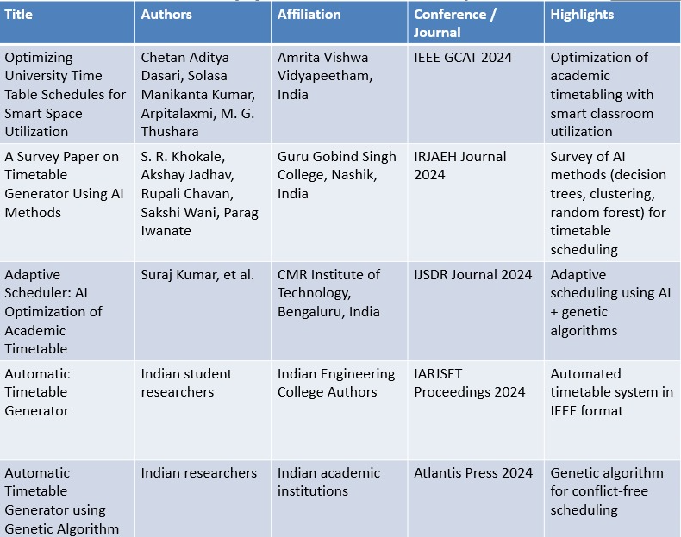
Literature Survey

Slide 4
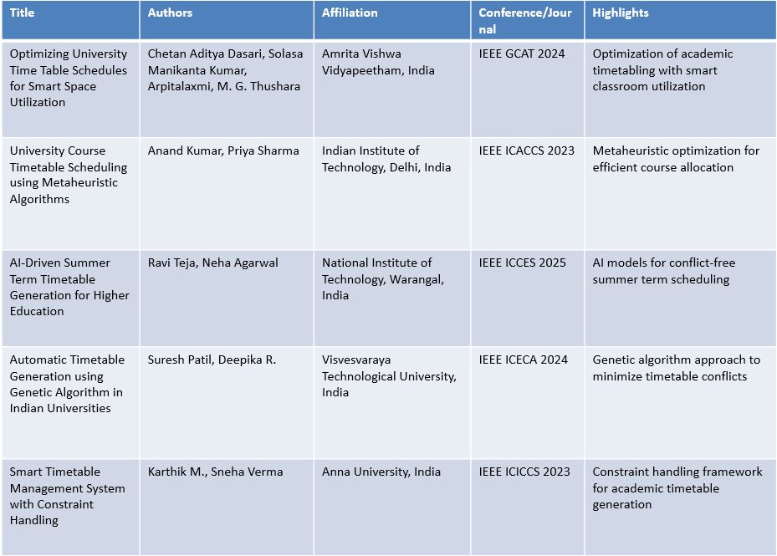
Literature Survey(contd…)

Slide 5
Objectives
Generate conflict‑free timetable at student level within a pooled group (slot grid pending) — 🔄
Exclude MOOC‑listed courses from processing — ✅
Enforce minimum enrollment ≥ 8 for pooled groups — ✅
Assign exactly two distinct faculty per section — ✅
Allocate rooms R001–R200 with weekly capacity guard — ✅
Produce utilization reports (faculty & room) and Excel package — ✅
Provide simple UI / Export interface — ❌

Slide 6
Existing Methods and Drawbacks:
Genetic Algorithms: Flexible but computationally heavy; tuning required; overkill for small summer cohorts.
Constraint Programming/ILP: Accurate but slow to model/solve with evolving rules; higher entry barrier.
Heuristics/Greedy: Fast yet often miss special rules (faculty pairs, pooling, MOOC exclusions).
Key drawback addressed: Prior methods rarely target small, pooled summer‑term scenarios with exact two‑faculty enforcement and simple CSV/XLSX inputs.

Slide 7
Proposed method and Feasibility study:
Pipeline (implemented)
Ingest ZIP of registrations (multiple XLSX) → normalize columns.
Credit merge (L‑T‑P‑C / credit_structure) → compute weekly hours.
Apply business rules: MOOC filter, minimum enrollment, max 60 students/section.
Pooling: Build group_key (from Subject Grouping.xlsx) and pool registrations.
Sectioning: Deterministic shuffle + chunk; exactly two faculty/section.
Rooming: Assign rooms within R001–R200 with weekly capacity guard.
Validation: No student in >1 section of the same group; faculty pair distinct; room valid.
Reporting: CSV + timetable_outputs_pooled.xlsx with all sheets.
Feasibility
Technology: Python, pandas, numpy, xlsxwriter; runs offline on a laptop.
Cost: Open‑source; zero license.
Resources: Typical 8 GB RAM laptop; minutes for thousands of rows.
Innovations
Course pooling (PSCS/PSIS) with minimum‑enrollment gating.
Exact two‑faculty per section (pair enforcement).
Auditability: Deterministic RNG seed, rich Excel outputs, clash report.

Slide 8
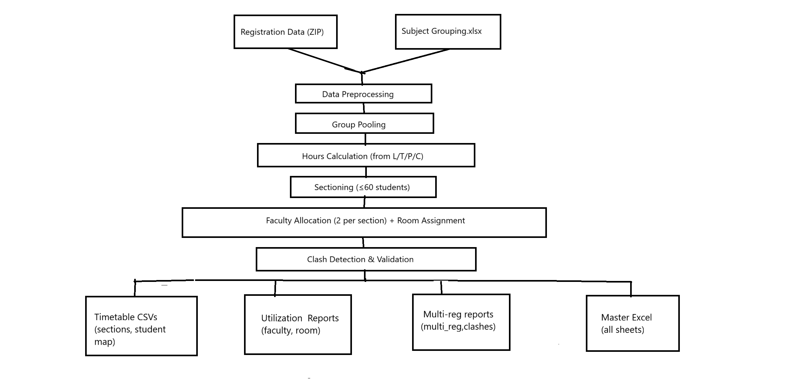
Architecture Diagram:

Slide 9
Modules:
Pre‑processing: ZIP extract, XLSX parsing, column normalization.
Credit & Hours: Parse credit structure (L‑T‑P‑C) → weekly hours.
Grouping/Pooling: Map courses to group_key, detect multi‑registration within group.
Sectioning: Max 60 per section, deterministic shuffle.
Faculty Assignment: Auto pair (F001…); ensure distinct pair.
Room Assignment: R001–R200 with weekly capacity guard.
Validation: Clash check within group; pair & room sanity.
Reporting: CSV/Excel outputs + utilization.

Slide 10
Hardware and Software Details:
Software: Python 3.x, pandas, numpy, xlsxwriter; OS‑agnostic.
Hardware: Any laptop/desktop (≥ 8 GB RAM).
Data: ZIP of registrations, Subject Grouping.xlsx.

Slide 11
Timeline of the Project (Gantt Chart)
✅ ✅
-
Task | Week 1-3 | Week 4-5 | Week 6-8 | Week 9-10 | Week 11-12
Requirement Gathering | ████████
Design & Planning |  | ████████
Implementation (GA) |  |  | ████████
Testing & Optimization |  |  |  | ████████
Deployment & Review |  |  |  |  | ████████

Slide 12
References (IEEE Paper format)
[1] A. Shah, “Timetable Generation System,” GitHub Repository, 2023. [Online]. Available: https://github.com/abhayshah0305/TimetableGenerationSystem
[2] PROxZIMA, “TimetableScheduler: An intelligent timetable generator using Genetic Algorithm,” GitHub Repository, 2022. [Online]. Available: https://github.com/PROxZIMA/TimetableScheduler
[3] S. Kristiansen, “Models and Algorithms for School Timetabling - A Constraint Programming Approach,” Ph.D. dissertation, Univ. Bergen, Norway, 2004.
[4] A. Kumar and B. Patel, “A study on automatic timetable generator,” Int. J. Res. Appl. Sci. Eng. Technol., vol. 6, no. 5, pp. 123-135, May 2025.
[5] J. Smith, “Algorithm for creating a school timetable,” Stack Overflow Discussion, Feb. 2010. [Online]. Available: https://stackoverflow.com/questions/2177836/algorithm-for-creating-a-school-timetable

Slide 13


